Slide 1

Predicting Student Success in High School Sciences
Yekaterina Bardash
Practicum 1
Regis University

Slide 2



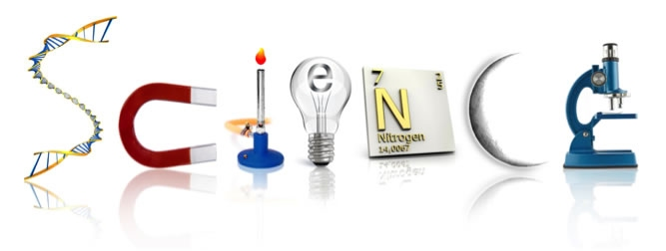
Motivations, Questions, and Limitations
Motivations
School resources, social good
Question 1
Is success in Physics, Chemistry, and Biology related?
Question 2
Can success be predicted from grades and demographics?
Limitations
Teacher style, grading, course changes

Slide 3





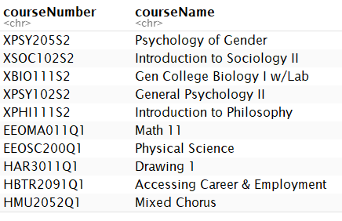

The Data
125 Columns
3955 Unique Students
175,353 Rows
484 Unique Courses
3 School Years
Notes:
HAVE DATA SET JUMP IN

Slide 4
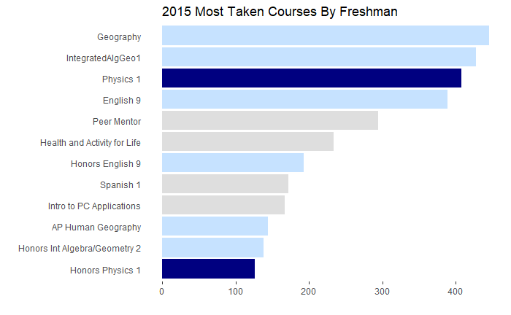

Exploratory Data Analysis
Outcome
Predictors
Notes:
573 unique students
102 unique courses

Slide 5

Number of Quarters Passed of Physics
Semesters Passed of Physics vs Biology
A pass is equal to an A, B, or C in 1 quarter. For example, 3 means the student passed 3 quarters with an A, B or C and failed 1 quarter with a D or F.
68 students (21%) passed more quarters of Physics
159
50%
4
5
3%
3
59 students
(18%) passed more quarters of Biology
30
9%
0, 1, 2
3
4
0, 1, 2
Number of Quarters Passed of Biology

Slide 6
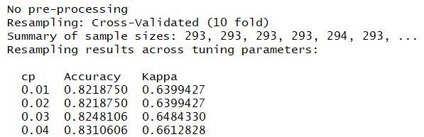
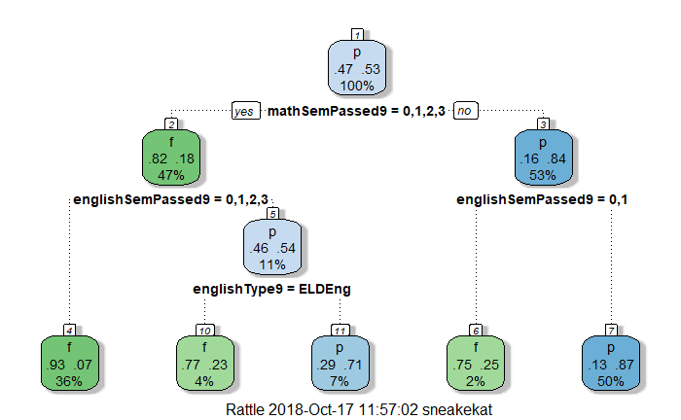

Predicting Physics (9th) Success Decision Trees (rpart package) - 86% Accuracy
Outcome:
pass (4 semesters) or fail (≤ 3) Physics
Classes: Math, English, History
Type of class: Honors, AP, etc.
Demographics: ELL, Gifted, etc.
Notes:
Good news…bad news…
Using 10-fold cross validation, found that complexity parameter value produced best accuracy and Kappa with 0.01
Experimented with trees
- https://www.edureka.co/blog/implementation-of-decision-tree/
- tried to add penalties to loss function for false positive (said they would pass, but failed) but that lowered accuracy at the expense of false negatives
Information vs gini split (LOOK THIS UP) – information only gave about 82% accuracy

Slide 7
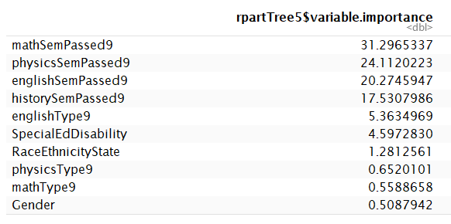
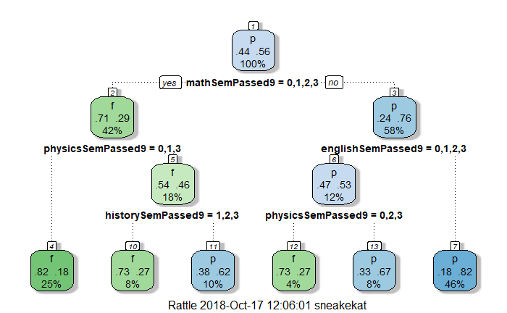

Predicting Chemistry (10th) Success Decision Trees (rpart) - 77.7% Accuracy
Outcome:
pass (4 semesters) or fail (≤ 3) Chemistry
Classes: 9th grade Math, English, History, Physics
Type of class: Honors, AP, etc.
Demographics: ELL, Gifted, etc.

Slide 8
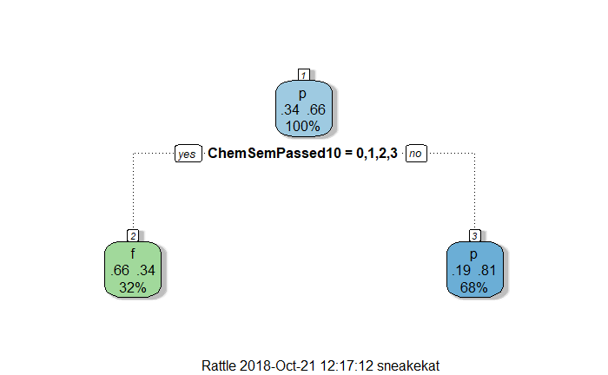
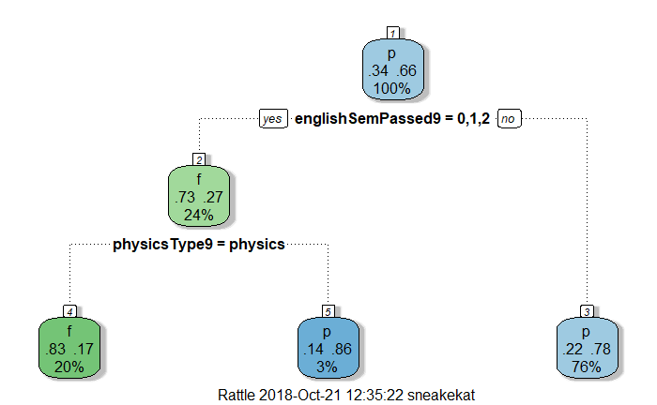

Predicting Biology (11th) Success Decision Trees (rpart) - 78% accuracy
Outcome:
pass (4 semesters) or fail (≤ 3) Chemistry
Classes: 9th grade Math, English, History, Physics, 10th grade Chemistry
Type of class: Honors, AP, etc.
Demographics: ELL, Gifted, etc.

Slide 9



Recommendations
Demographics Downplayed
Core classes are key
Chemistry Success
Chemistry success can determine success in Biology better than freshman year grades
Physics
Slightly more students pass more semesters in Physics than Biology or Chemistry. Most pass the same number of semesters for both.
Science Scores Are Not Independent
Success in one relates to success in another
Notes:
Limitations

Slide 10
Limitations
01 Type of Science Class Not Fully Considered
Pass of fail for all classes (Honors, AP, Regular) were lumped together.
02 Year to Year Differences Not Considered
Future analysis could be done on whether this model predicts success for a different cohort (more data)
03 Include Other Variables
Attendance, behavior referrals, involvement in extracurricular activities

Slide 11

Conclusion
Question 1
Is success in Physics, Chemistry, and Biology related?
Question 2
Can success be predicted from grades and demographics?
https://github.com/yekbar/PredictingStudentSuccess

Slide 12
References
Eizmendi, M. (2016). Science image. [digital image]. Retrieved from https://sites.google.com/site/gcmseizmendi/

Slide 13
APPENDIX

Slide 14
The Process
Raw
Data
Initial Data Cleaning
Relations of science classes
correlations.rmd
Predicting: p/f in Physics
Variables: ALL classes in 2017 ML2017only.rmd
Predicting: p/f in Physics, Chemistry, Biology
Variables: core classes freshman year ninth2015.rmd
Data cleaning / preprocessing
Data cleaning / preprocessing
Data cleaning / preprocessing
Chi Square & Visualizations
Logistic regression & Random Forest
Decision Trees

Slide 15
Number of Quarters Passed of Chemistry
Semesters Passed of Chemistry vs Physics
A pass is equal to an A, B, or C in 1 quarter. For example, 3 means the student passed 3 quarters with an A, B or C and failed 1 quarter with a D or F.
51 students
(16%) passed more quarters of Chemistry
166
52%
4
5
2%
3
61 students (19%) passed more quarters of Physics
36
11%
0, 1, 2
4
3
0, 1, 2
Number of Quarters Passed of Physics

Slide 16
Number of Quarters Passed of Chemistry
Semesters Passed of Chemistry vs Biology
A pass is equal to an A, B, or C in 1 quarter. For example, 3 means the student passed 3 quarters with an A, B or C and failed 1 quarter with a D or F.
48 students (15%) passed more quarters of Chemistry
167
52%
4
12
4%
3
52 students
(16%) passed more quarters of Biology
40
13%
0, 1, 2
4
3
0, 1, 2
Number of Quarters Passed of Biology

Slide 17
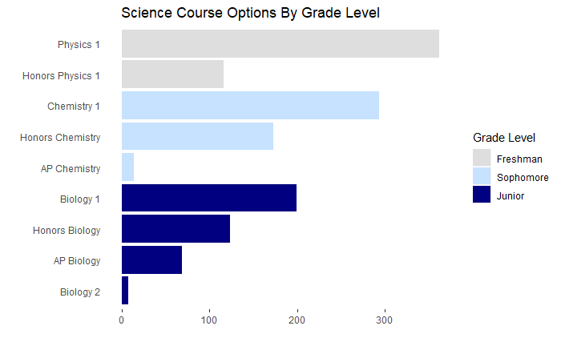
Exploratory Data Analysis
Notes:
573 unique students
102 unique courses

Slide 18
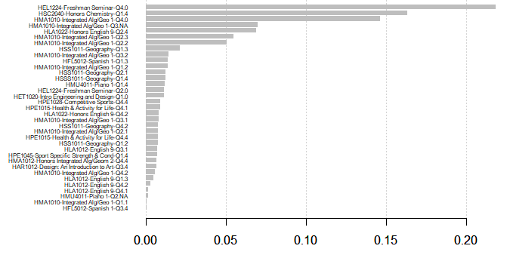
Model 1 – Predicting Physics Success Logistic Regression – 78.6% Accuracy
Outcome:
pass (4 semesters) or fail (≤ 3) Physics
Predictors:
Classes: All Freshman Classes by Quarter, dummy coded
Demographics: ELL, Gifted, HomePrimaryLang, etc
Notes:
At first I was getting only about 53 % accuracy
To find the most important variables, I used extreme gradient boosting or XGB which uses gradient boosting decision tree algorithm
- gradient bosting explanation
http://blog.kaggle.com/2017/01/23/a-kaggle-master-explains-gradient-boosting/
https://arxiv.org/pdf/1603.02754.pdf

Slide 19
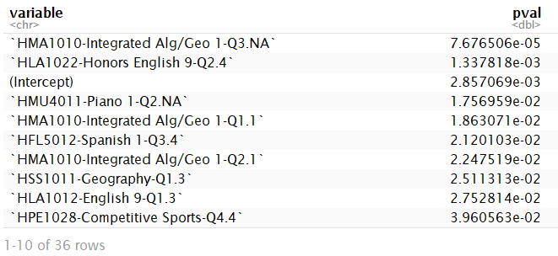
Model 1 – Predicting Physics Success Logistic Regression – 78.6% Accuracy
 | Actual fail | Actual Pass
Predicted fail | 80 | 20
Predicted pass | 17 | 56
Outcome:
pass (4 semesters) or fail (≤ 3) Physics
Variables:
Classes: All Freshman Classes by Quarter, dummy coded
Demographics: ELL, Gifted, HomePrimaryLang, etc
Notes:
`HMA1010-Integrated Alg/Geo 1-Q3.NA`
`HLA1022-Honors English 9-Q2.4`
`HSS1011-Geography-Q1.3`
`HMA1010-Integrated Alg/Geo 1-Q2.1`

Slide 20
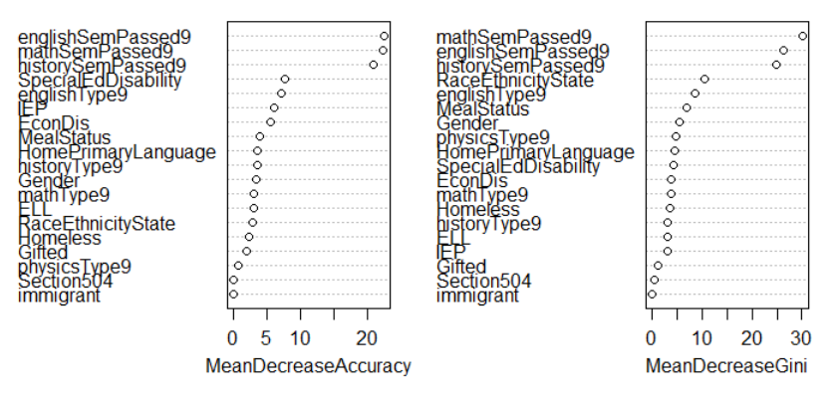
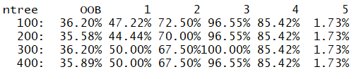
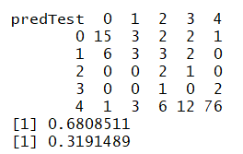
Model 2: Predicting Physics Success Random Forest - 68% Accuracy
Outcome:
0, 1, 2, 3, or 4 semester of Physics Passed
Predictors:
Classes: Math, English, History
Type of class: Honors, AP, etc.
Demographics: ELL, Gifted, etc.

Slide 21
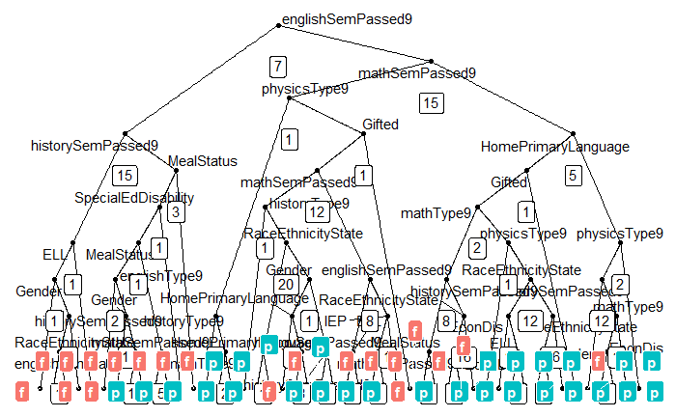
Model 3 – Predicting Physics Success Random Forest 86% Accuracy
Outcome:
pass (4 semesters) or fail (≤ 3) Physics
Classes: Math, English, History
Type of class: Honors, AP, etc.
Demographics: ELL, Gifted, etc.
Notes:
Good news…bad news…

